Slide 1
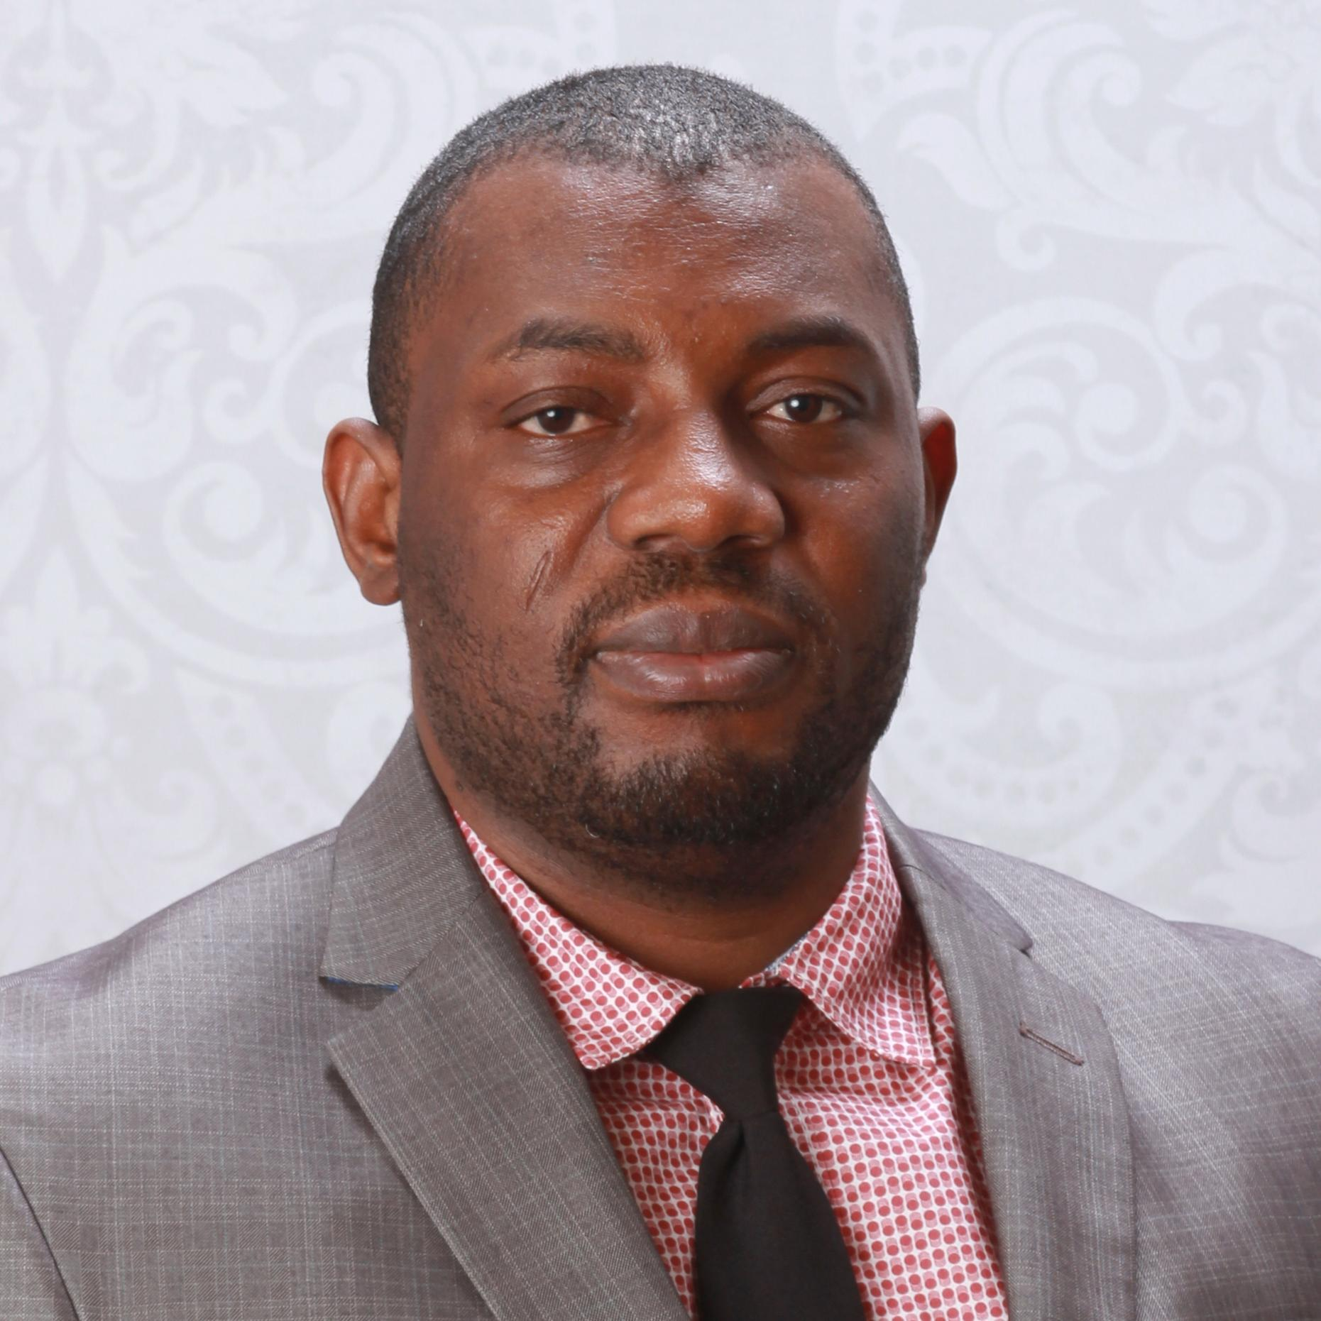
Francois Tchoumo Quality Engineering Associate Manager
Professional Experience:
Accenture Federal Services Project Experience
Automation Test Lead - Client – USAC (Apr 2022 - Present)
Participate actively in and contribute to Sprint Planning, Daily Standups, Backlog Refinement, Sprint Reviews, and Sprint Retrospectives
Perform various types of testing such as Smoke Testing, Sanity Testing, Integration Testing, Performance Testing, Security Testing, Exploratory and Regression Testing
Create a requirement traceability matrix, QC Tests checklist, and Test closure reports
Specify, design, implement, and test automation framework in python using testing tools such as Selenium WebDriver, and Selenium Grid, Playwright
External Project Experience
QA Test Lead - Client – Collabera (Feb 2021 – Mar 2022)
Performed Backend Database testing using complex SQL Joins and validated the database
Designed test scenarios, test plans, test cases, and set up the CI/CD pipeline
Tracked bugs and reported defects using Azure DevOps, Jira, and Confluence
QA Test Lead - Client – Agilious - USAID (Nov 2019 – Feb 2021)
Conduct 508 compliance testing using tools such as: WAVE and ANDI
Collaborated with technical leads to define testing methodologies for scalable, reliable applications using Selenium and CI/CD pipelines
Ensured system resilience, quick response times, data protection, and vulnerability shielding
Background:
Francois is a motivated Senior Automation Test Engineer, results driven with more than 15 years of experience in designing, implementing, and optimizing large-scale robust cross-functional teams test automation frameworks across complex enterprise systems. Francois has strong track record of identifying critical defects, enhancing product quality, and collaborating closely with cross-functional teams in Agile environments. Francois is recognized for his leadership in Test architecture, mentoring QA teams, and driving continuous process improvements that reduce risk.
Contact:
francois.tchoumo@afs.com
571-353-9866
Skills:
Education:
Design and build automation frameworks
CI/CD Integration and maintenance
Metrics and Status Reporting
Selenium, Cucumber, JMeter, Cypress
API, functional, and performance testing
Agile, QA strategy, and mentoring
Cross-functional collaboration
Java, JavaScript, SQL, Git, AWS, Ansible
M.S. Computer Science – University of Dschang
B.S. Computer Science – University of Dschang

